Slide 1
Slide 2
Joins, Sub Queries, Index

Slide 2
Joins
Equi | =
non-equi | >, <, >=, <=, <>
Self | Self
Outer

Slide 3
Vendor Specific Way of writing query
1 | select …… from emp e, dept d where e.deptno = d.deptno | equi join
2 | select …. From emp e, dept d where e.deptno > d.deptno | non-equi
3 | select … from emp e, dept d where e.deptno *= d.deptno | Left outer join
4 | select … from emp e, dept d where e.deptno =* d.deptno | right outer join

Slide 4
ANSI SQL 1999
select …. From emp join dept using deptno
select …. From emp using dept on (e.deptno >d.deptno)
select …. From emp left outer join dept using deptno
select …. From emp right outer join dept using deptno
select ….. From emp full outer join dept using deptno
equi join
non-equi
Left outer join
right outer join
full outer join

Slide 5
Joins vs Sub Queries
Joins are always faster than Sub Queries
Sub Queries can not be avoided all together
Where condition slows down the query performance
In Joins the Query engine uses the optimum path to retrieve data
 | Table A | Table B
Join | 4 | 4 | 4+4
Sub query | 4 | 4 | 4*4

Slide 6
Writing a join with multiple conditions
A(65000) | a.CITY = CHENNAI | b=e | C-A
B(10) | ENO=101 | d | D
C(8,00,000) | EMAILID=‘someone@gmail.Com | a | E
D (50000) | SAL>10000 | c | B
E (20) |  |  | EMAILID | Eno
 |  |  | CITY | EMAILID
 |  |  | SAL | SAL
 |  |  | ENO | CITY
Notes:
Join Big Tables first

Slide 7
Join Order
JOIN from Big Tables to Small Then filter by: PRIMARY KEY, UNIQUE, INDEXED COLUMN, NUMBERIC COLUMN (=,>), DATE, CHAR

Slide 8
Sub Queries

Slide 9
How many Sub queries can a query have
32 sub queries
8 sub queries
per processor
/ core
{ or }

Slide 10
How do you frame a Sub Query

Slide 11
Types of Sub Queries
Single row | = > < >= <= <>
Multi row | in / any / all
Multi-column | more than column
scalar
Inline query / Derived Table | Top N Analysis
Correlated Subquery
To find all employees whose salary is greater than “Srini’s” Salary,
first get the salary of Srini (the criteria for the entire task - sub query ) ,
then write an outer query to list all employee details whose sal is greater than the sal found from the sub query

Slide 12
Single | =, >, <, >=, <=, <> | Select * from emp where sal = (select max(sal) from emp) ; select * from emp where sal > (select sal from emp where ename='Srini'));
scalar |  | select concat(‘Hi! ', (select ename from emp where empno='101'))

Slide 13
ORDER BY clause is invalid in subqueries
--The ORDER BY clause is invalid in views, inline functions, derived tables, subqueries, and common table expressions, unless TOP, OFFSET or FOR XML is also specified.
Select * from Orders where freight in (select freight from orders order by Freight desc);
Select * from Orders where freight in (select top 3 freight from orders order by Freight desc)

Slide 14
Inline or Derived Table
select min (BirthDate)
From (select top 3 BirthDate
from employees order by BirthDate desc) a;

Slide 15
How to find the second / third or the n^{th} max salary receiver from the Employee Table
How to find the second / third or the n^{th} Oldest person from the Employee Table

Slide 16
Inline query / Derived Table | Top N Analysis | select * from emp where sal =(select max(sal) from emp where sal < (select max(sal) from emp where sal < (select max(sal) from emp))) ; select * from emp where sal = (select min(sal) from (select top 6 sal from emp order by sal desc) a)

Slide 17
Inline query / Derived Table
select * from emp where sal =
(select max(sal) from emp where sal <
(select max(sal) from emp where sal <
(select max(sal) from emp))) ;
-- sub query with dirived table
select * from emp where sal =
(select min(sal) from - - sub query
(select top 3 sal from emp order by sal desc) a); -- derived table

Slide 18
North wind
Select orderid, freight from orders
Select orderid, freight from orders order by Freight asc
select top 3 freight from orders order by Freight asc
Select orderid, freight from orders order by Freight desc
select top 3 freight from orders order by Freight desc
--Third highest freight
select orderid, freight from orders order by Freight desc
Select Min(freight) from (select top 3 freight from orders order by Freight desc) a
--second highest freight
select orderid, freight from orders order by Freight desc
Select Min(freight) from (select top 2 freight from orders order by Freight desc) a

Slide 19
Top N Analysis cannot be done by Joins.
It can be done only by using Sub Queries

Slide 20
Index

Slide 21
Types of Index
Clustered Index
  Only one per Table
  Based on Primary Key or Unique Key
Non – Clustered Index
  Max 249 per table
  Index on Normal Columns
  Most used columns in the where clause
  Created for Master tables

Slide 22
Index
Indexing is a mechanism to access a value / data with out performing a full table scan.
When to have an index?
Do we need index for a very small table
Do we need an index when we are reading all the records
Notes:
Index is

Slide 23
Index should be created only on very large tables, where the requirement is to get a few records from the table with out performing a full table scan.
Index are not required on small tables, or when the requirement is to fetch the entire records from the table

Slide 24
Do | Don't
Too Large | Too small
normal Columns (Col that are not PK/ unique) | PK and Unique
column frequently used in where condition | columns that are rarely used
Master | Transaction*
If transaction tables have an index , and then on deleting few records the index must be recreated using an Auto sys function else index may point to a non existing row. (Use jobs for running Autosys)
Maintaining index on a transaction table is an overhead for the SQL Engine.
Avoid creating Non Clustered Index for Transaction Tables. Create only for Master Tables

Slide 25
Non Clusterd | Status | Reason
select * from emp where ename='Ramki' | Slow | full table scan
create index i1 on emp(ename) |  | Non functional index
select * from emp where ename='Ramki' | Fast | Fast
select * from emp where upper(ename)='RAMKI' | Slow | full table scan
create index i2 on emp(upper(ename)) |  | Functional Index
select * from emp where upper(ename)='RAMKI' | faster | faster
select * from emp where ename='%KI' | Slow* | full table scan
select * from emp where ename='RAM%' | Faster | Faster
alter index e1 disable | disable
alter index e1 rebuild | Enable
alter index i1 reorganize | **
* While searching based on an indexed column at least the first char must be known.
** useful for transaction table, where records get deleted frequently ( de-fragmentation)
Don’t Create too many indexes on the same column

Slide 26
Temp Tables Vs Temp Variables Vs Common Table Expressions (CTE)

Slide 27
Temp Table

Slide 28
When to use Temp Tables
For Testing Data
Or for Intermediate Transformation of data or as a staging area – while moving data from one table to another table.
No other usage
A Temp Table is Single User. Not shared with concurrent users.
If a Stored procedure creates a Temp table and if multiple users run the sp, then in the TempDB for each user a temp table is created .
Create table #t1(c1 integer)
Use Global Temp Table for Sharing data with multi users

Slide 29
Temp Table
Create table #t1(c1 integer)
insert into #t1 values(1)
insert into #t1 values(2)
insert into #t1 values(3)
select * from #t1

Slide 30
Scope of Temp Table
Either on drop of the temp table or
On close of the session.
Note:
  Closing the sql query tab will end the current session

Slide 31
Issues
If a temp table is used in a stored procedure, then every time the sp is executed the sql-engine will jump from the currentDB to the TempDB to create & access the temp table and then return back to the currentDB.
This will be a huge over head to the application
If the sp is called simultaneously by multi users say 1000 users then the switch between the databases will be at least 1000 * 3 times.
There are scenarios where the currentDB and the TempDB may be in different SQL Instances altogether, this will increase the io access also

Slide 32
Global Temp Table

Slide 33
Global Temp Table
create table ##gt1(c1 integer)
Scope
When all the connections are lost or
When the Server is Shutdown
Usage
For Collaboration

Slide 34
Temp Variable

Slide 35
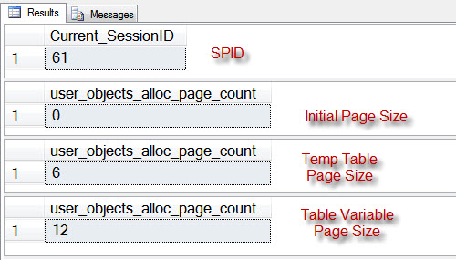
Temp Variable
Temp Table, and Temp Variables — both are created in TempDB and not in memory. Temp Variables are faster than a Temp table
<<See Demo in SQL Server>>
The size of the table variable and temp table is the same and created in TempDb.
Scope of Temp Variable:
With in the Stored Procedure in which the temp variable is defined

Slide 36
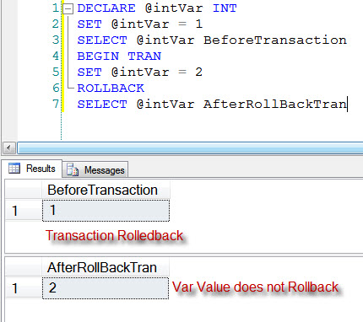
Difference Temp Table and Table Variable
– Effect of Transaction
Variables are unaffected by transaction as their scope is very limited,
Demo

Slide 37
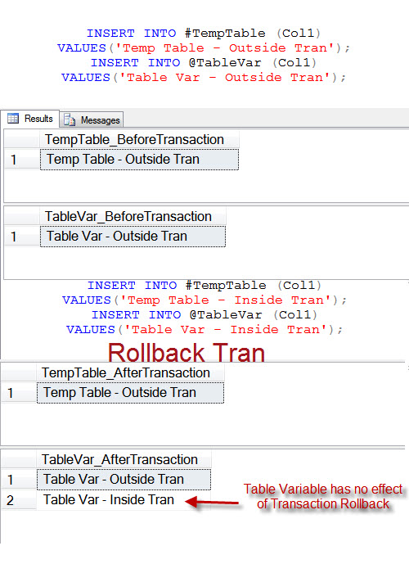
Table Variables are true variables, they demonstrate the same behavior like any local variable. Table variables are not affected by transactions.
Never use TempTable and TableVariables interchangeably without understanding their effect on transaction.

Slide 38
Magic Table

Slide 39
Magic Table
There are two Magic table namely Inserted and Deleted.
If we have an Emp table, and when we try to add a new row to the table the following steps will take place.
1) Do constraint Violation check
2) Then add the new row to the (magic) inserted table
3) Execute all the Triggers for the table if any
4) Finally insert the record in to Emp table and remove the data from the magic table

Slide 40
Magic Table Deleted
When we try to delete a row from the table the following steps will take place.
1) constraint Violation check
2) Then move the row to the (magic) deleted table
3) Execute Trigger for the table if any
4) Finally delete the record from the emp table and remove the data from the magic table

Slide 41
In Case of Updates
constraint Violation check
2) Then move the current row to the (magic) deleted table (101,a,5000) – Original Version
3) Then add the new updated values to the (magic) inserted table (101,a,9000)
4) Execute all the Triggers for the table if any
5) Finally save the record in to emp table from the inserted table and remove the data from the deleted table
In case of rollback copy the data from the deleted table

Slide 42
Output
INSERT TestTable (ID, TEXTVal)
OUTPUT Inserted.ID, Inserted.TEXTVal
INTO @TmpTableVALUES (1,'FirstVal')
DEMO: for Insert, Delete , and Update

Slide 43
CTE – Common Table Expression

Slide 44
CTE – Common Table Expression
It is like an in lined query
A named temporary result set based on a SELECT query
Result set can be used in SELECT, INSERT, UPDATE, or DELETE
Advantages of common table expressions:
  Queries with derived tables become more readable
  Provide traversal of recursive hierarchies

Slide 45
SELECT *
FROM (
SELECT Employeeid SalesPersonID,
Count(*) NoOfOrders
FROM Orders GROUP BY EmployeeID ) a
WHERE SalesPersonID IS NOT NULL
ORDER BY NoOfOrders DESC

Slide 46
WITH TopOrders (Employeeid, NumSales) AS
( SELECT Employeeid, Count(*)
FROM Orders GROUP BY EmployeeID )
SELECT * FROM TopOrders
WHERE Employeeid > 5
ORDER BY NumSales DESC

Slide 47
WITH TopSales (SalesPersonID, NumSales) AS
( SELECT SalesPersonID, Count(*)
FROM Sales.SalesOrderHeader GROUP BY SalesPersonId )
SELECT * FROM TopSales
WHERE SalesPersonID IS NOT NULL
ORDER BY NumSales DESC

Slide 48
Performance Tunning Cycle
1 |  | Keywords
2 | Don’t use | Analytical Functions / seeded functions | If Keywords can be used
3 | Don’t use | Joins | If Analytical functions can be used
4 | Don’t use | inline queries - CTE | If Joins can be used
5 | Don’t use | Sub queries | If Inline queries can be used
6 | Don’t use | Table Variables | If Sub Queries can be used
7 | Don’t use | Global Temp Tables | If Temp Variables can be used
8 | Don’t use | Temp Tables | If GTT can be used
9 | Don’t use | Cursors | If Temp Table can be used
10 | Don’t use | While Loop. | If a cursor can be used

Slide 49
Under pressure
you don’t rise to the occasion,
You sink to the level of your Training.
That’s why we train hard.
Seek being uncomfortable …..
That is where you will find greatness

